Slide 1


INSURANCE
Probability Course - Sekolah Data Pacmann
pacmann.io
© 2022 – Pacmann AI

Slide 2
Outline
Introduction
Dataset
Descriptive Statistic Analysis
Categorical Variables Analysis
Continuous Variables Analysis
Variables Correlation
Hypothesis Testing
Conclusion

Slide 3
Introduction
Notes:
Transisi antar outline

Slide 4
Introduction
A motivating background to do this project
Health insurance is substantial in order to protect user from unexpected, high medical costs. Moreover, good insurance companies need to be well-calculated to work effectively as well as continuously. Health insurance users need to pay for charges regularly (premi) to the insurance company where some requirements of user need to be checked. The value of charges is various for each users because there are many factors that influence the user value. Some of those decision factors are age, gender, region, smoking habit and body mass index. Through this project, variables and their properties that affect user charge value can be analyzed.

Slide 5
Dataset
Notes:
Transisi antar outline

Slide 6
Dataset
In this dataset there are 1338 user profile used which contain age, gender, body mass index, number of children, smoking habit, region, and charges value. The details are:
Age from 18 to 64
Gender: male or female
Body mass index (BMI) from 15.96 to 53.13
Number of borne child from 0 to 5
Smoking habit : smoker or non-smoker
Region: northeast, northwest, southeast, and southwest
Charges value from 1121.8739 to 63770.42801

Slide 7
Descriptive Statistics Analysis
Notes:
Transisi antar outline

Slide 8
Mean of Age
By using original dataset, Mean of age from dataset is 39.21. This value shows average users of health insurance are in productive age.
Moreover, by using sorted smokers and non-smokers data, mean of age of smoker is 38.51 while 39.39 for non-smokers.
Interestingly, data proportion of smokers is small only about 20.48% of users while non smokers 79.52%

Slide 9
Mean of Charges
By using original dataset, Mean of charges from dataset is 13270.422.This value shows average users charges of health insurance is quite high.
Moreover, by using sorted smokers and non-smokers data, mean of charges of smoker is 32050.23 while 8434.27 for non-smokers. Pertaining to the calculation mean of the data charges of smokers is about four times higher than non-smokers one. While the difference is huge, it can be assumed that smoking habit gives quite big impact to the user value or value of charges.
However, variance of the data charge of smokers is 133207311.2 while for non-smokers is 35925420.5. these calculation highlight variance of the data charges of smokers and non-smokers are different where smokers data charges are more variable from mean of charges

Slide 10
Mean of BMI
Initially, by using original dataset, Mean of BMI from dataset is 30.66.This value shows most users of health insurance is in obese range (30-40). It is also nothing different with mean of BMI women (30.94) and men (30.38) from gender sorted dataset and also smokers (30.71) and non-smokers (30.65) from smoking habit sorted dataset, most of them are in the obese range.
From BMI above 25 and smoking habit sorted dataset, mean of charge is calculated where mean of charge of smokers with BMI above 25 is 35116.91 and for non-smokers with BMI above 25 is 8659.59. most of smokers charge is higher than non smokers and in addition with BMI, the average result is even higher and it leads to assumption that smoking habit combined with high BMI affect more impact than only smoking habit for charges value of health insurance users.

Slide 11
Mean age of women and men who smoke
Initially, the original data is sorted into smoker and non-smokers. Afterward, separate smokers data and sort men and women in that area. Then, calculate differently by using women area and excel formula “average” in age row, mean of age of women who smoke can be obtained. Finally, repeat calculation by using men area and excel formula “average” in age row, mean of age of men who smoke can be obtained
Mean of age of women who smoke from dataset is 38.61
While mean of age of men who smoke from dataset is 38.44
Pertaining to the calculation Mean of age of women who smoke and men who smoke are different where Mean of age of women who smoke is higher than men had.

Slide 12
Categorical Variables Analysis
Notes:
Transisi antar outline

Slide 13
Charges value women and men
By using original dataset, Mean of charges from dataset is 13270.422.This value shows average users charges of health insurance is quite high.
Moreover, by using gender sorted data, there are 662 women and 676 men of users which is quite similar. It means 49.48% and 50.52% consecutively proportion of women and men. Mean of women charges of smoker is 12569.58 while 13956.75 for men. Pertaining to the calculation mean of the data charges of men is slightly higher than men one. While the difference is small, it can be assumed that gender gives quite small impact to the user value or value of charges.

Slide 14
Proportion of smokers and non smokers
By using sorted smokers and non-smokers data, proportion of smokers and non smokers can be counted. From 1338 users, 274 users are smokers while 1064 users are non-smokers. Based on those data, 0.2048 (20.48% ) is proportion of smokers and the rest 0.7952 (79.52% ) is proportion of non smokers. Non smokers user are far higher than smokers user.

Slide 15
Proportion of charges in each region
By using region sorted data, proportion charge of each region can be counted. From 1338 users with total charges of 17755824.99, 324 users are from northeast with total charges of 4343668.583 where its 0.2446 charge proportion. 325 users are from northwest with total charges of 4035711.997 where its 0.2277 proportion . 364 users are from southeast with total charges of 5363689.763 where its 0.3021 charge proportion. 325 users are from southwest with total charges of 4012754.648
where its 0.2260 proportion.

Slide 16
Proportion of region
By using region sorted data, proportion charge of each region can be counted. From four regions, 3 regions are almost similar in proportion about 0.24 (nourtheast 0.2422, northwest 0.2429, southwest 0.2429) while southeast region is slightly higher about 0.2720

Slide 17
Proportion of female and male smokers
By using gender sorted smokers data, proportion of female smokers can be counted. From 274 smoking users, 115 are women while 159 users are men. Based on those data, the proportion of user is a female when its known she is a smoker is 0.42 whereas the proportion of user is a male when its known he is a smoker is 0.58. the male smokers proportion is higher than female smokers.

Slide 18
Charge data distribution for each region
By using region sorted data and make class range and frequency for every region the charges distribution can be highlighted, According to the curve, most of first, sixth, seventh, and eighth class range is northeast users while for the second class range, southwest user.

Slide 19
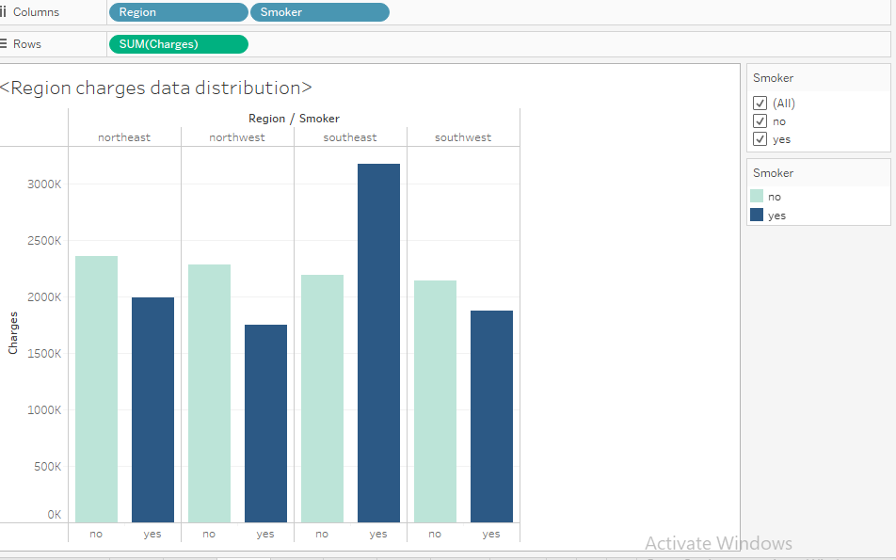
Charge data distribution for each region
By using tableau features distribution of total charges per region is easily shown. According to the curve, total charges of non smokers are almost similar for all region while smokers in southeast pay the highest health bill among other regions.

Slide 20
Continuous Variables Analysis
Notes:
Transisi antar outline

Slide 21
Proportion of charges according to BMI
By using BMI sorted data, BMI >25 and the rest are separated then sorted by the charges, proportion of BMI and charges each region can be calculated. From 1338 users, 196 users (0.1465 proportion) are with BMI under 25 and health bill lower than 16700 while 51 (0.0381 proportion) users with higher charges. Moreover, 808 users (0.6039 proportion) are with BMI above 25 and lower charges and then 283 users (0.2115 proportion) are with BMI above 25 and high charges.

Slide 22
BMI vs Smokers
Which one is more probable, someone has high bmi given he has high charges or someone has high bmi given he has lower charges?
It is more probable someone has high BMI given he has lower charges with 0.6039 proportion. It is due to most of users of this health insurance have high BMI value.
Which one is more probable, someone has high bmi given he has high charges or someone has lower bmi given he has high charges?
It is more probable someone has high BMI given he has high charges with 0.2115 proportion. It is due to most of users of this health insurance have high BMI value.

Slide 23
Probability of someone has high charges given he’s a smoker
By using charges sorted smokers data, proportion of smokers and charges can be calculated. From 274 smoking users, 254 user are have high charges with 0.9270 proportion while only 20 users have low charges with 0.0730 proportion. users are men. Based on those data, the probability of someone has high charges given he is a smoker are really high. So that smoking habits increase immensely the probability of high charges.
smokers with charges >16700 | 254 | 0.927007
smokers with charges <16700 | 20 | 0.072993
 | 274

Slide 24
Variables Correlation
Notes:
Transisi antar outline

Slide 25
Correlation
By using original dataset and tableau, correlation between variables are easily calculated and displayed.
1. Correlation between charges and BMI value results r-squared of 0.0394 which it means this correlation is very weak.
2. Correlation between charges and BMI value for smoking users results r-squared of 0.6504 which it means this correlation is quite strong. Correlation using smoking users data is clearer to see charges since smoking habit gives huge impact of it.
3. Correlation between charges and age result r-squared of 0.7056 which is strong correlation between them.
4. Correlation between charges and age in male who smoke data results r-squared of 0.4548 which means this correlation is not strong enough.
5. Correlation between charges and age in not smoking users results r-squared of 0.9231 which means its very strong correlation between age and charges. It highlights that age also is substantial factor to determine charges in health insurance.

Slide 26
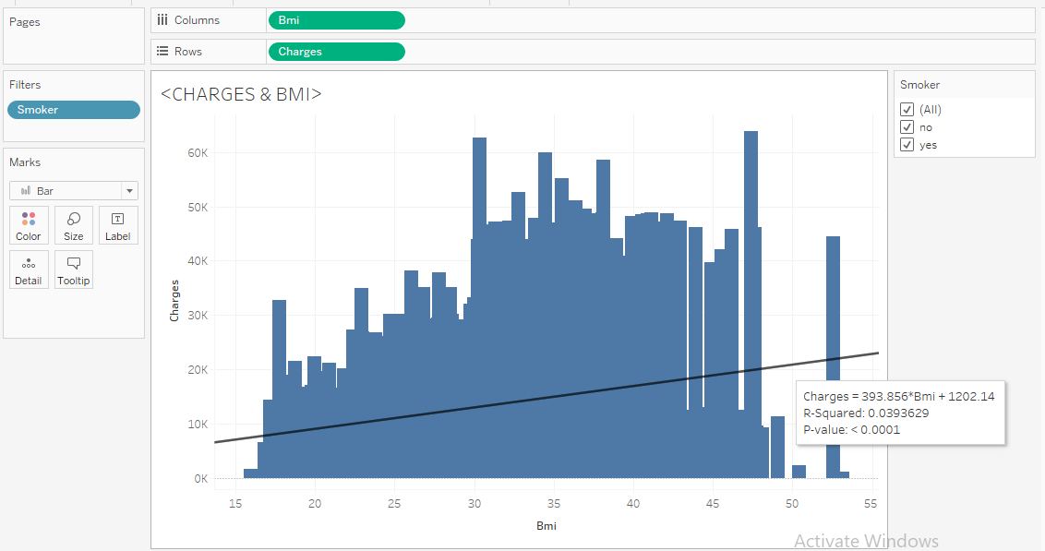

Slide 27
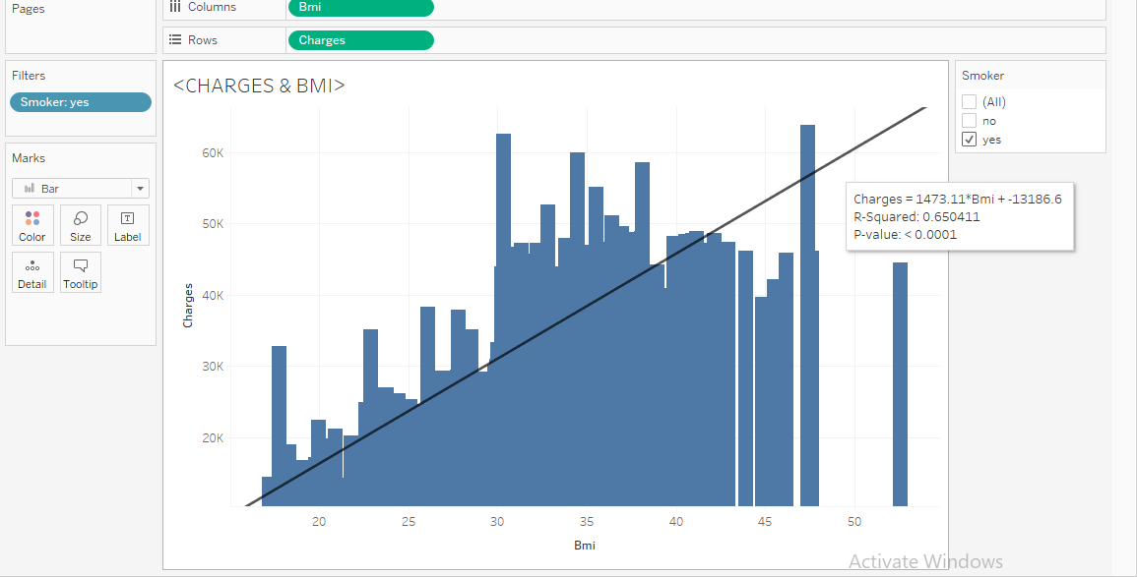

Slide 28
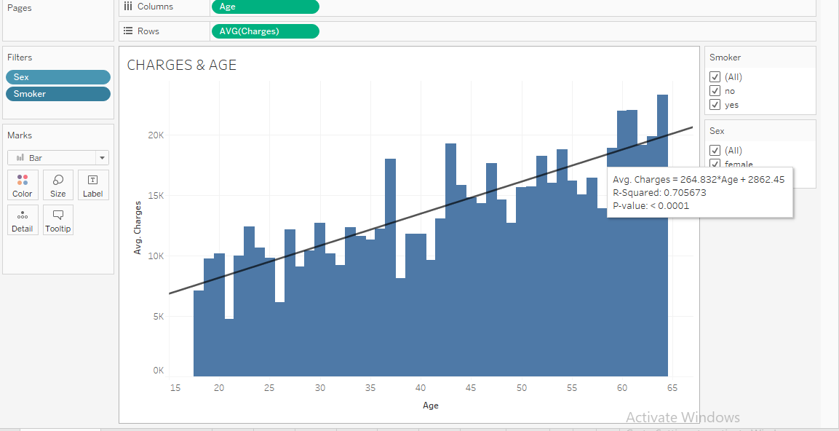

Slide 29
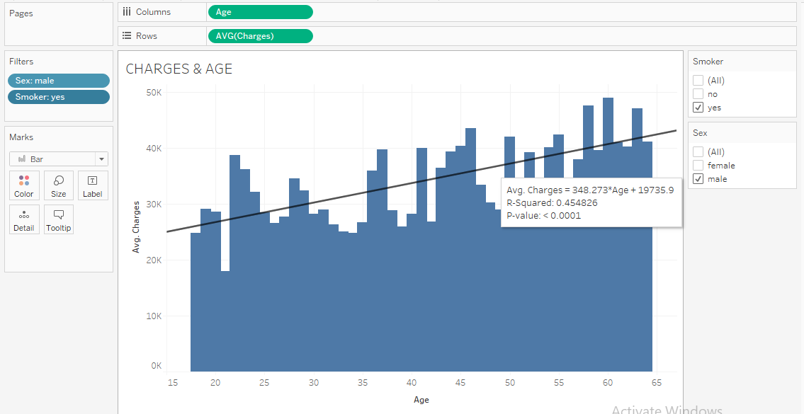

Slide 30
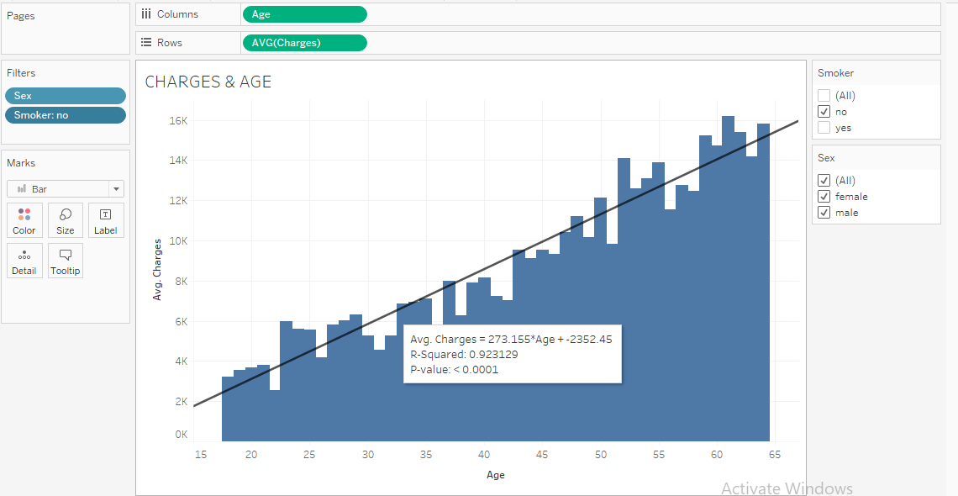

Slide 31
Hypothesis Testing
Notes:
Transisi antar outline

Slide 32
Smoker’s charges are higher than non smoker’s
Original data set is sampled randomly to get only 50 data charges of each category. By using anova table in excel, p-value is obtained. P-value for sampled data is 0.4460.
H₀ : ρ₁ > ρ₂ smoker charges are higher than non smokers
H_{a} : ρ₁ ≤ ρ₂ smoker charges are lower than non smokers
p-value for these data is 0.4458 so do not reject H₀ in α significance of 5% because p-value is greater than α. There are enough evidence to claim that smoker’s charges are higher than non smoker’s
ANOVA
Source of Variation | SS | df | MS | F | P-value | F crit
Between Groups | 25968141 | 1 | 25968141 | 0.585958 | 0.445826 | 3.938111
Within Groups | 4.34E+09 | 98 | 44317417
Total | 4.37E+09 | 99

Slide 33
BMI>25’s charges are higher than BMI<25’s
Original data set is sampled randomly to get only 50 data charges of each category. By using anova table in excel, p-value is obtained. P-value for sampled data is 1.02E-21.
H₀ : ρ₁ > ρ₂ BMI >25’s charges are higher than BMI <25’s
H_{a} : ρ₁ ≤ ρ₂ BMI >25’s charges are lower than BMI <25’s
p-value for these data is 1.02E-21 so reject H₀ in α significance of 5% because p-value is much lower than α. There are not enough evidence to claim that BMI >25’s charges are higher than BMI <25’s
ANOVA
Source of Variation | SS | df | MS | F | P-value | F crit
Between Groups | 2.78E+09 | 2 | 1.39E+09 | 68.37647 | 1.02E-21 | 3.057621
Within Groups | 2.99E+09 | 147 | 20309064
Total | 5.76E+09 | 149

Slide 34
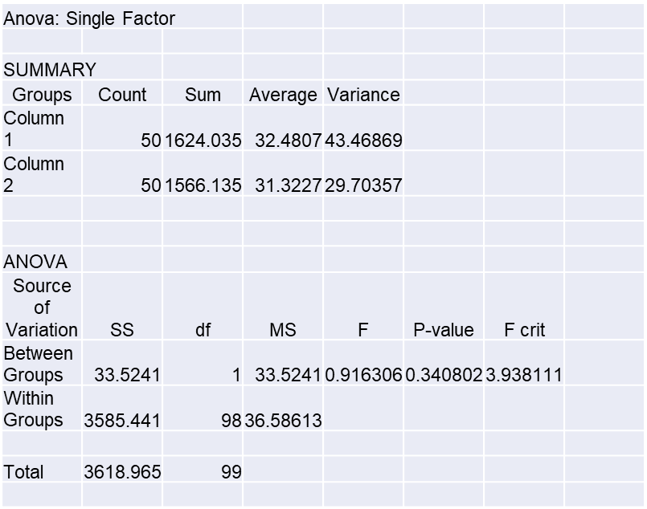
Male BMI are similar to female BMI
Original data set is sampled randomly to get only 50 data charges of each category. By using anova table in excel, p-value is obtained. P-value for sampled data is 0.3408.
H₀ : ρ₁ = ρ₂ Male BMI are similar to female BMI
H_{a} : ρ₁ ≠ ρ₂ Male BMI are different to female BMI
p-value for these data is 0.3408 so do not reject H₀ in α significance of 5% because p-value is greater than α. There are enough evidence to claim that Male BMI are similar to female BMI

Slide 35
Conclusion
Notes:
Transisi antar outline

Slide 36
Conclusion
In conclusion, based on correlation to charge’s value, smoking habit is the most substantial factor in order to determine charge’s value. However, in non smoker group, age is the most substantial factor to determine charge’s value.
Smoker’s charges are higher than non smoker’s
Male BMI are similar to female BMI

Slide 37
Notes
Need more time to finalize it

Slide 38
Reference
Tableau. 2022. https://drive.google.com/file/d/1bg8sYJR4Ko03os9KHgd-rR8yiWEP6gpQ/preview
Bray G.A. 2004. Classification and Evaluation of the Overweight Patient. New York.
Marcel Dekker
Insurance information institute. 2022. https://www.iii.org/article/what-determines-price-my-auto-insurance-policy

